Slide 1
Final Project On-board Testing Results
Neural Network Inference on FPGA
ECE 6213
Osama Yousuf, Joseph Riem

Slide 2
Specification
Linear Neural Network for image classification
Dataset: MNIST
Contains 60,000 training images, 10,000 testing images
Inference Accuracy (%) is used as the verification metric!
Out of the 10,000 images, what’s the % the network can correctly classify?
Each image is of handwritten digits labelled 0-9, and is 28 x 28 pixels originally
For FPGA implementation, we have reduced the problem size to 18 x 18, and have binarized images (image pixels are either 0 or 1).
Network architecture:
2-layer perceptron network
324 x 10 x 10 (initial tests show that this is a good fit for our for FPGA)
Activations: ReLU (easier to implement on FPGA compared to Sigmoids)
Loss: CrossEntropy (okay to use anything - happening in software)

Slide 3
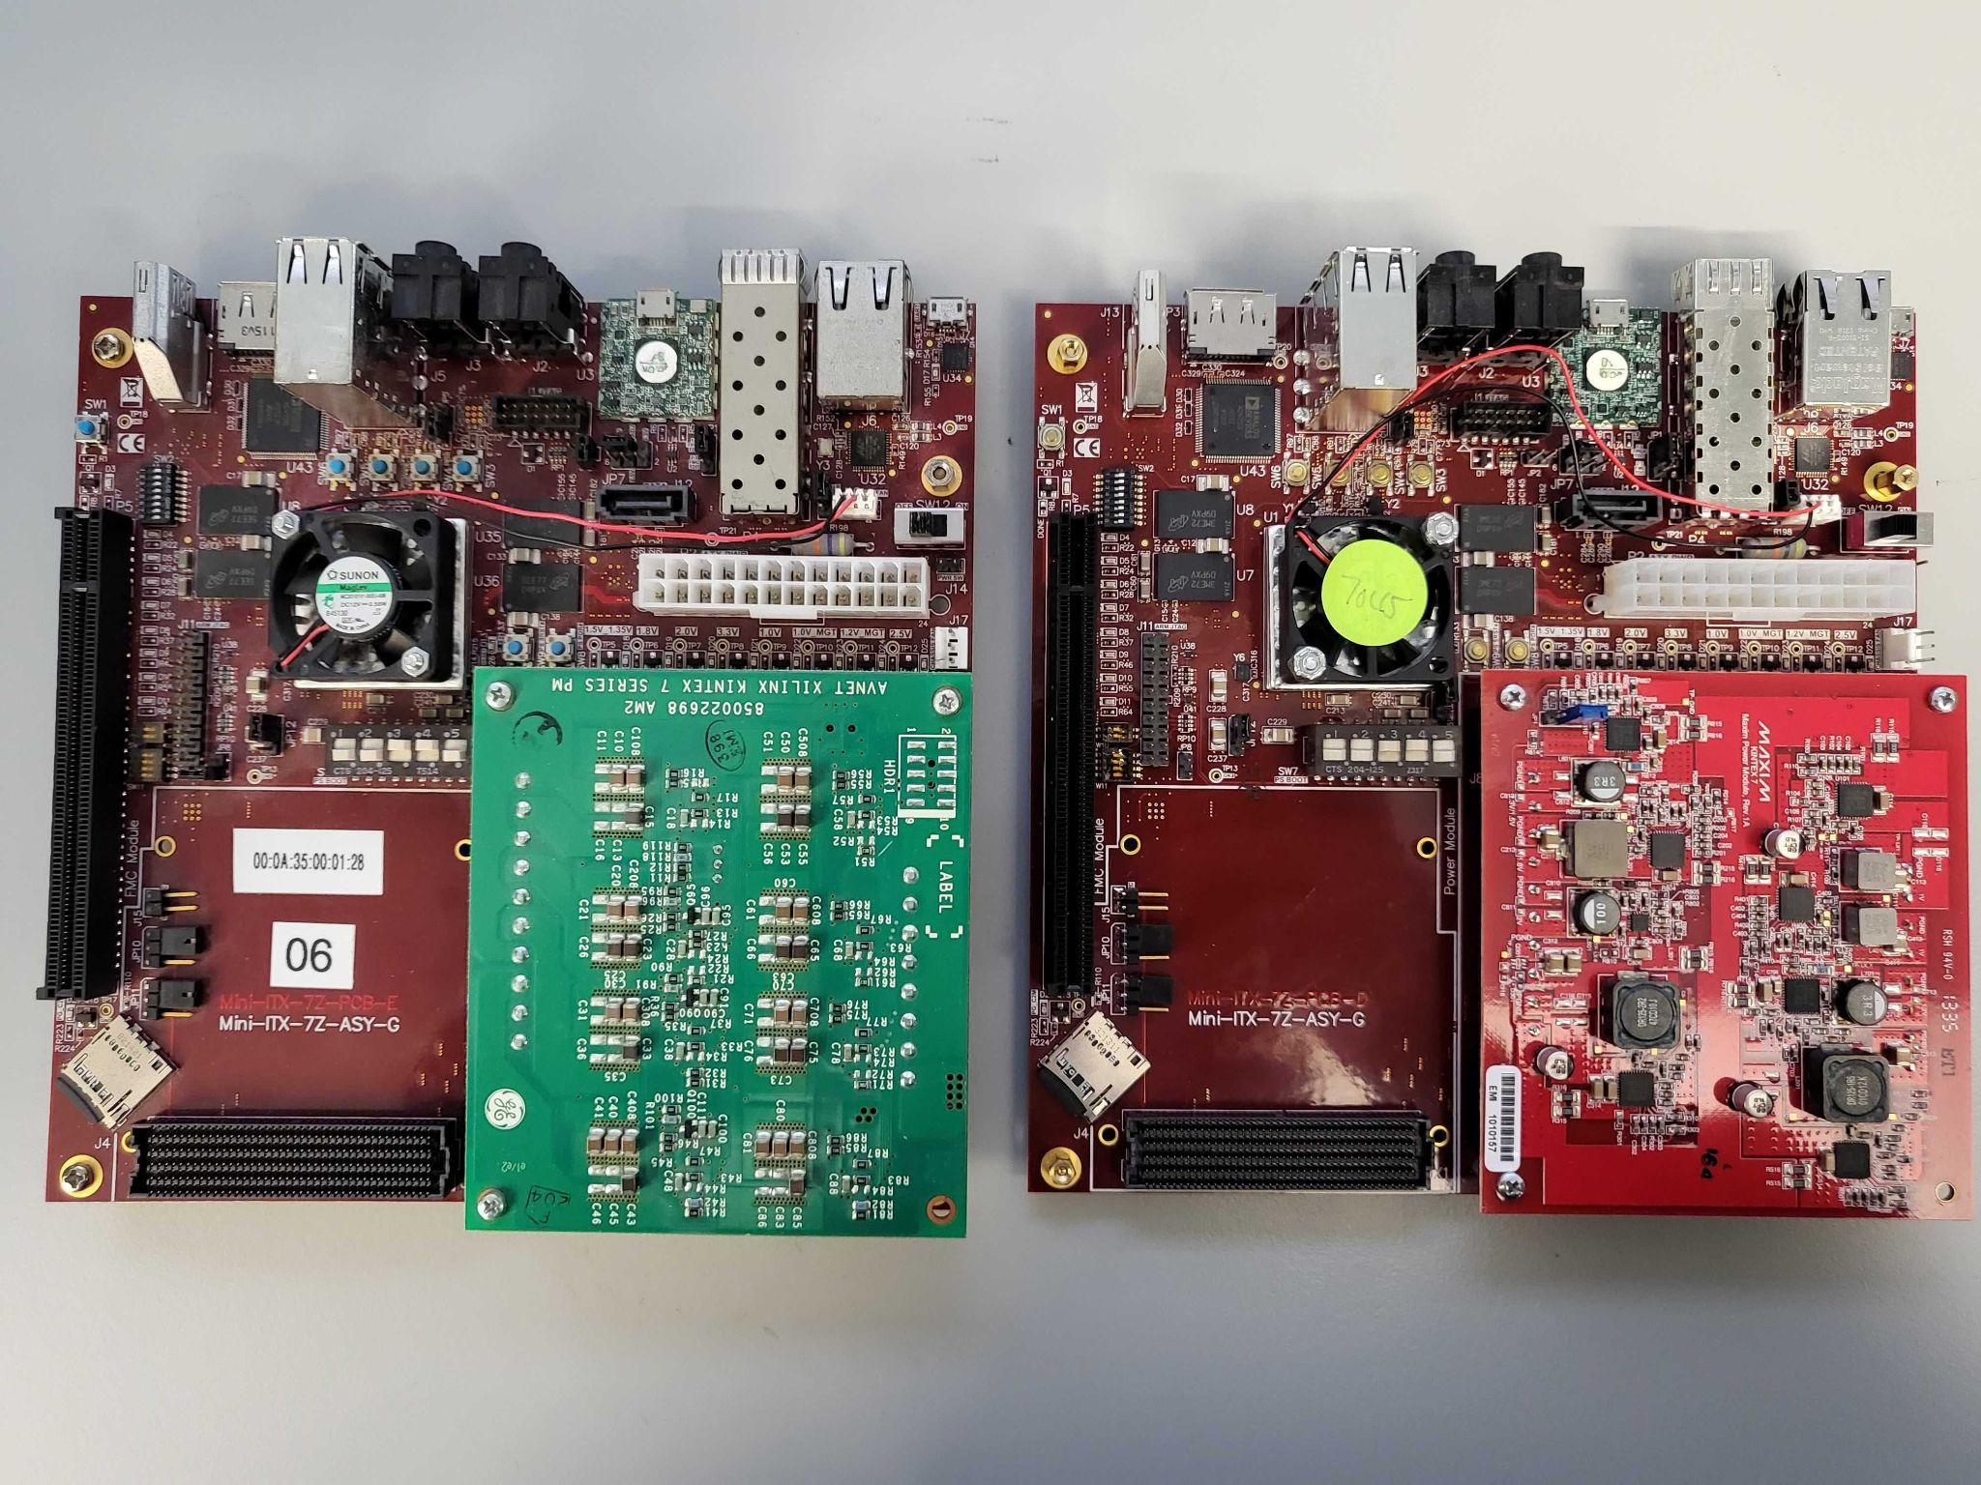
Progress Overview
Phase 0: Implement neural network training in software
Phase 1: RTL simulation for neural network inference
Phase 2: Synthesize + Deploy RTL on Mini-ITX Zynq 045/100 FPGA
High Level Synthesis mostly done, Custom RTL pending
Phase 3: Study how reducing network bit-precision impacts network accuracy (%)
Simulations done, on-board verification pending
Phase 4: Implement inference based on live-camera feed instead of preset testing dataset
Mini-ITX Boards in ADAM Lab @ GW
Hard processor (PS) + FPGA Fabric (PL)

Slide 4
Progress Update
High-level Synthesis (HLS)
Directly generate RTL code for inference based on Python code using HLS libraries (hls4ml, Vivado HLS)
Almost wrapped up!
Simulation + Synthesis + Implementation done
PS sends images to the neural network on PL via a DMA interface.
Custom RTL
Write our own RTL code for inference
Simulation results verified!
Synthesis + Implementation remains
Need to figure out RTL packaging so that PS-PL communication can be utilized
Web Camera Integration
Faced a hiccup, PS doesn’t recognize USB devices
Worked around by having a camera run over network
The PS can capture an image over ethernet!
Needs finishing touches once we have ironed out the custom RTL branch.
Stage 0
Development Setup
Stage 1
High-Level Synthesis
Custom RTL
Stage 2
Web Camera Integration
Stage 3
Class Presentation + Report

Slide 5
Workflow for the High-Level Synthesis (HLS) branch
Step 1: Network training in PyTorch
Step 2: Conversion from Python to C
Step 3: Conversion from C to RTL
Step 4: Block Diagram for the Mini-ITX board – Synthesis + Implementation
Step 5: PYNQ Overlay + Python Driver
Step 6: Final Inference

Slide 6
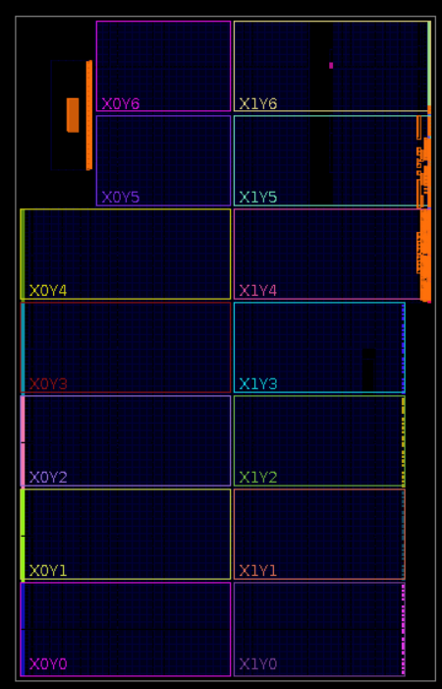
HLS Synthesized Design

Slide 7
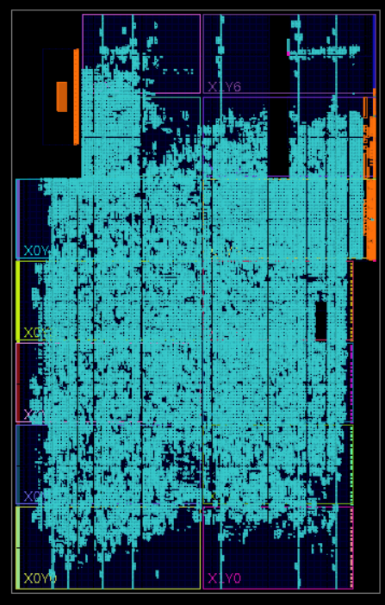
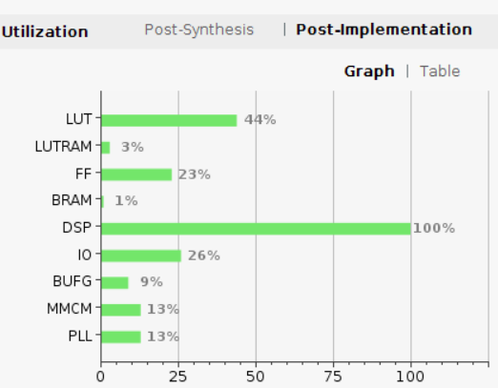
HLS Implemented Design
Utilization Report

Slide 8
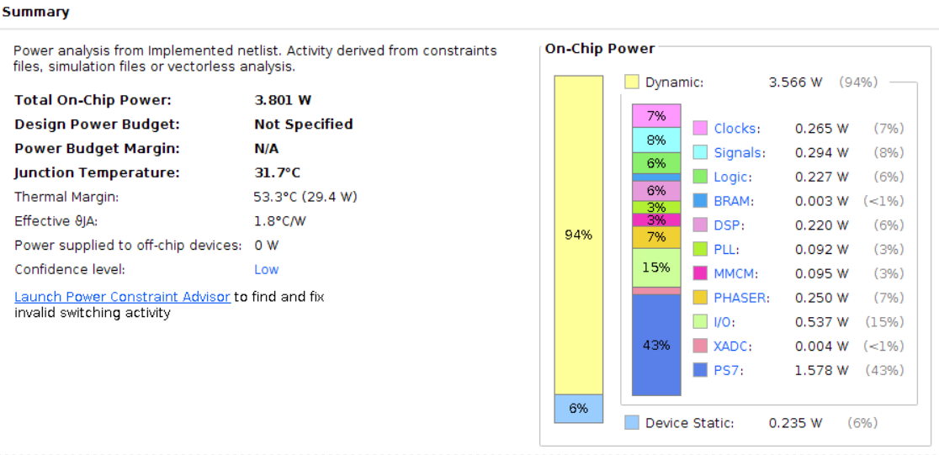
HLS Network – Power Report

Slide 9
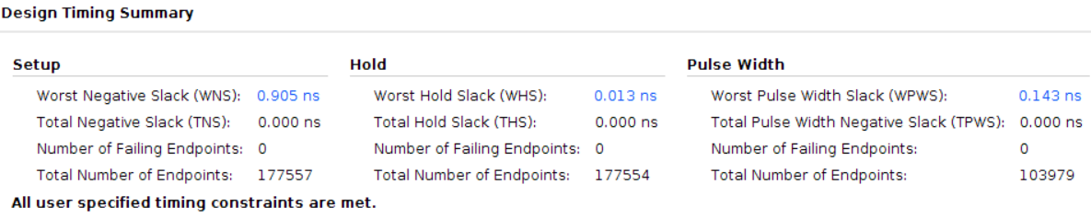
HLS Network – Timing Report

Slide 10
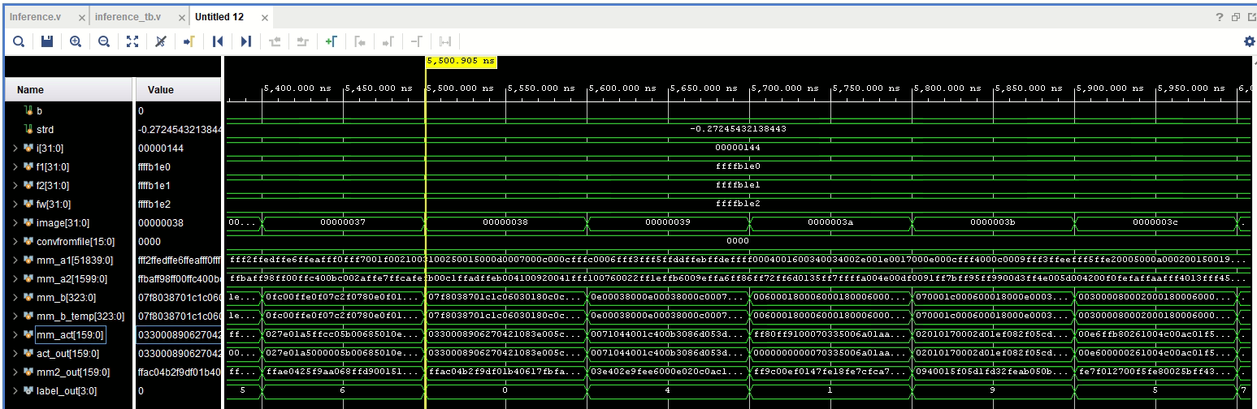
Custom RTL – Simulation Waveforms
The testbench loads a test image every #100 time units and we can see that a prediction is made on label_out, which is a number [0, 9]
Recall that there’s a total of 10,000 testing images!
Layer 1 Weights
Layer 2 Weights
Input Image
Layer 1 Output
ReLU Output
Layer 2 Output
Output Prediction

Slide 11
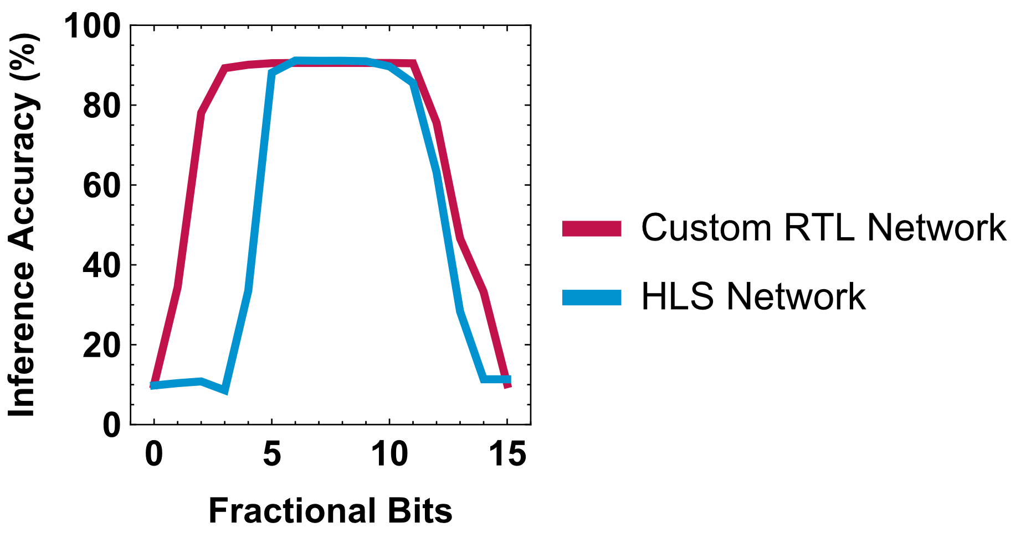
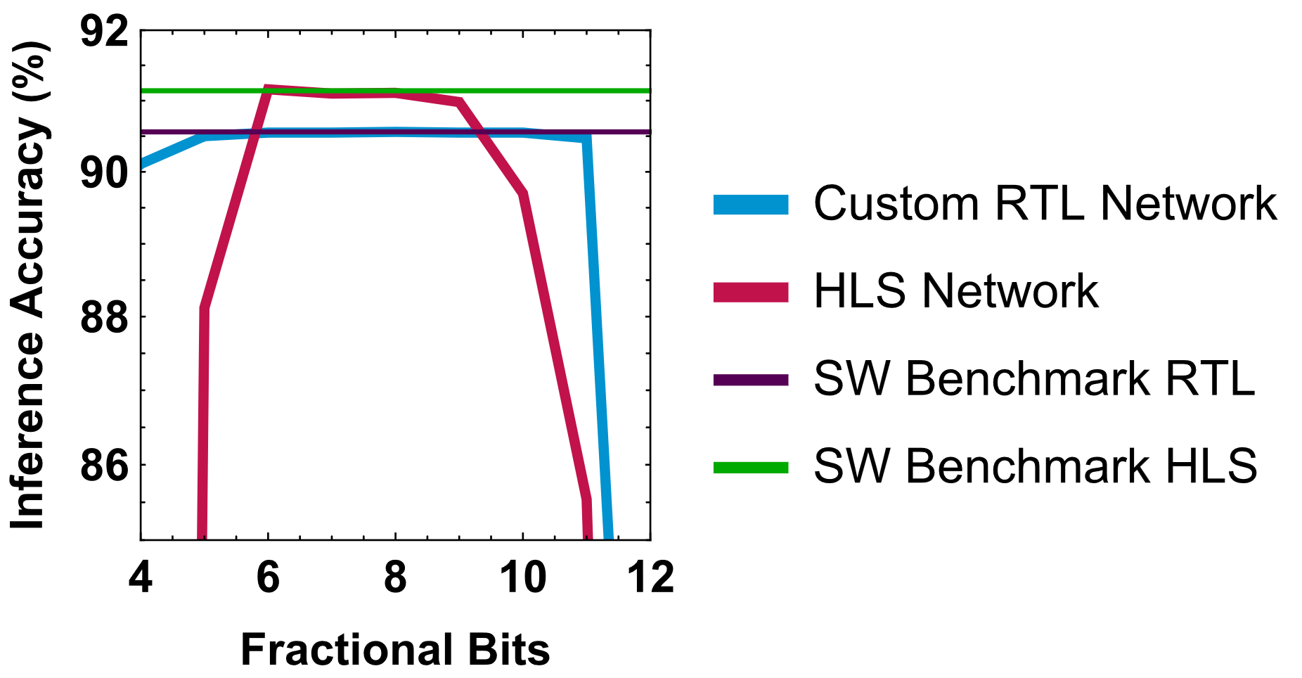
Exploring Weight Quantization
Observations:
HLS network can achieve higher accuracy, but has a tighter quantization window compared to the custom RTL
Differences:
Weights are different, HLS network is trained with biases (additional internal parameter), RTL network has only weights
Over/underflow handling is different
in custom RTL – we max/min out the weight
in HLS – default strategy, needs investigation!
Recall that we have a total of 16 bits, 1 of which is for the sign
HLS: 32-bit floating point software benchmark: 91.14 %, Fixed point peak: 91.16 % @ 6 FB
RTL: 32-bit floating point software benchmark: 90.56 %, Fixed point peak: 90.56 % @ 8 FB

Slide 12
Next steps
Perform synthesis and implementation
Code is already synthesizable
Layout all the ports
Use the SoC on the board to load in files to initialize matA for both layers
Create custom RTL Block for I/O integration
This week we are programming the FIFO RTL onto our FPGAs
If all goes well we can try loading our RTL onto the FPGAs and compute full accuracy on-board
Get camera feed integrated with on-board networks

Slide 13
Thank You Questions/Comments?

